Slide 1
SKIN DISEASE DETECTION AND CONSULTATION WEBSITE

Slide 2
Supervised By | Proposed By
Dr. Fernaz Narin Nur Adjunct Faculty, Department of Computer Science and Engineering | Mysha Maliha Priyanka | ID: 2020-1-60-230
 | K. M. Safin Kamal | ID: 2020-1-60-235

Slide 3
TABLE OF CONTENTS
1. OBJECTIVES
2. FEATURES
3. TOOLS
4. DATABASE
5. Demonstration

Slide 4
OBJECTIVE
Skin diseases are common, but people often don't take them seriously. Many don't seek medical help or take medication. Yet, some skin diseases can lead to skin cancer. Therefore, we aim to create a website for empower users with accurate diagnoses, professional medical advice, and a supportive community.

Slide 5
MAIN FEATURES
AI Detection from Images
Consultation on Skin Disease
Community Forum
User Profile and so on

Slide 6
TOOLS
HTML
CSS & Bootstrap
JS & JSON
PHP
MySQL

Slide 7
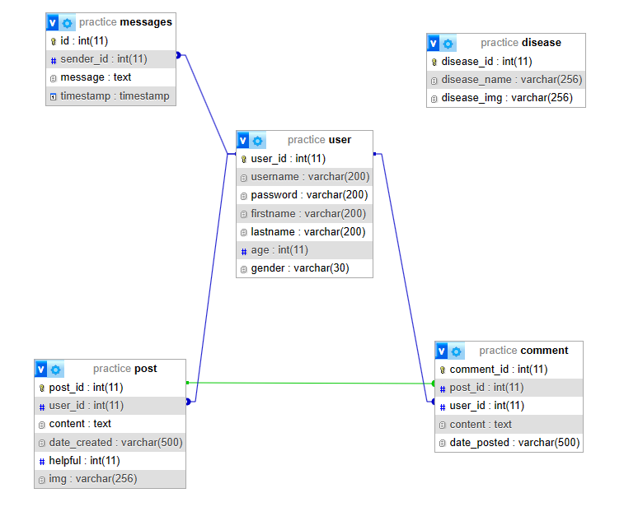
DATABASE

Slide 8
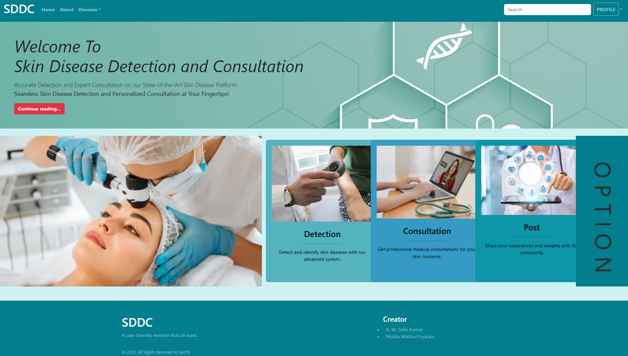
DEMONSTRATION

